Slide 1
Introduction to Deep Learning for Image Analysis
Piotr Teterwak
Dato, Data Scientist

Slide 2
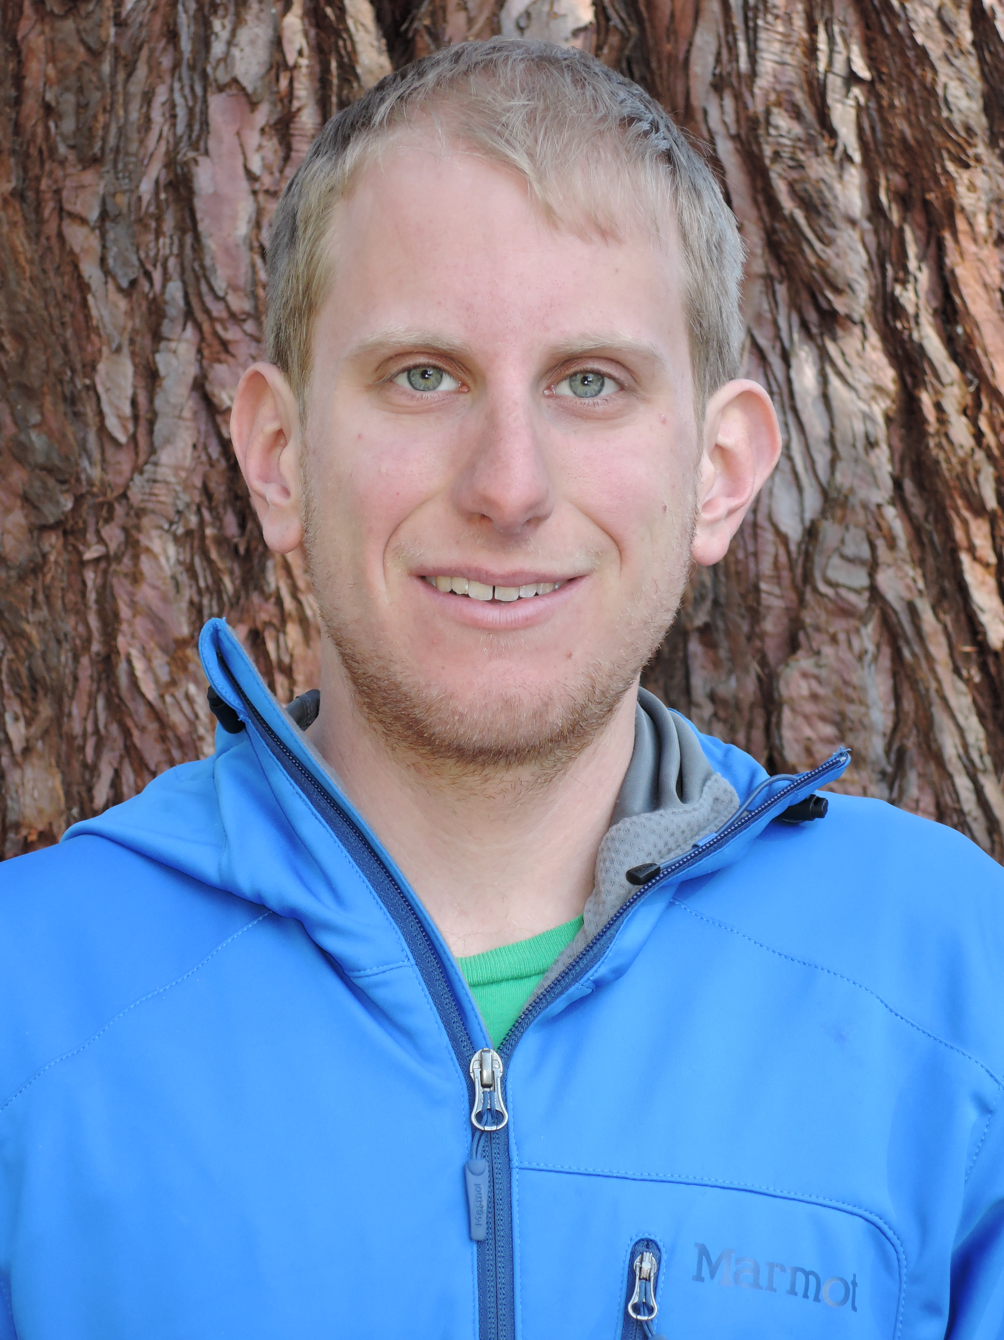
Hello, my name is…
Piotr Teterwak
Data Scientist,
Dato

Slide 3
Today’s tutorial
Deep Learning Overview
Training a model on CIFAR
Building a Similar Dress Recommender

Slide 4
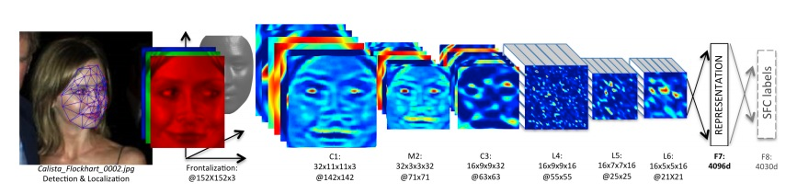
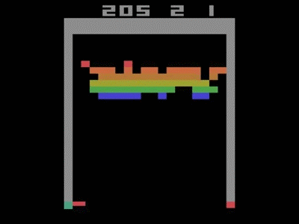
Deep Learning

Slide 5

Today’s talk

Slide 6
Deep Learning: Very non-linear models

Slide 7
Linear classifiers
Most common classifier
Logistic regression
SVMs
…
Decision correspond to hyperplane:
Line in high dimensional space
w₀ + w₁ x₁ + w₂ x₂ > 0
w₀ + w₁ x₁ + w₂ x₂ < 0
w₀ + w₁ x₁ + w₂ x₂ = 0

Slide 8
What can a simple linear classifier represent?
AND
1
0
0
1

Slide 9
What can a simple linear classifier represent?
OR
1
0
0
1

Slide 10
What can’t a simple linear classifier represent?
XOR
1
0
Need non-linear features
0
1

Slide 11
Non-linear feature embedding
1
0
0
1

Slide 12
Graph representation of classifier: Useful for defining neural networks
Input
Output
1
w₀
x₁
w₁
> 0, output 1
w₂
x₂
y
w₀ + w₁ x₁ + w₂ x₂ + … + w_{d} x_{d}
…
w_{d}
< 0, output 0
x_{d}

Slide 13
What can a linear classifier represent?
x₁ OR x₂ | x₁ AND x₂
1
-0.5
1
-1.5
1
1
x₁
y
x₁
y
1
1
x₂
x₂

Slide 14
Solving the XOR problem: Adding a layer
XOR = x₁ AND NOT x₂ OR NOT x₁ AND x₂
z₁
z₂
1
-0.5
1
-0.5
1
-0.5
1
x₁
z₁
y
-1
1
-1
x₂
1
z₂
Thresholded to 0 or 1

Slide 15
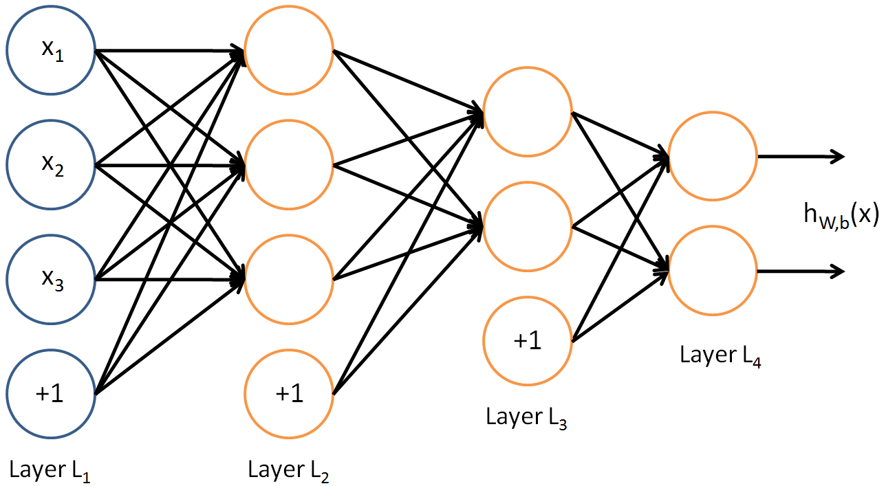

Deep Neural Networks
P(cat|x)
P(dog|x)
http://deeplearning.stanford.edu/wiki/images/4/40/Network3322.png

Slide 16
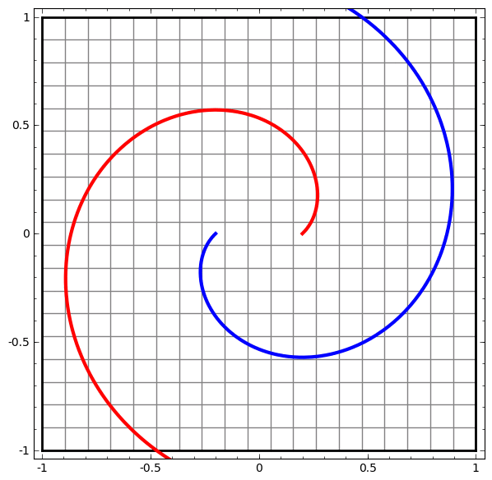
Deep Neural Networks
P(cat|x)
P(dog|x)
http://deeplearning.stanford.edu/wiki/images/4/40/Network3322.png

Slide 17
Deep Neural Networks
Can model any function with enough hidden units.
This is tremendously powerful: given enough units, it is possible to train a neural network to solve arbitrarily difficult problems.
But also very difficult to train, too many parameters means too much memory+computation time.

Slide 18
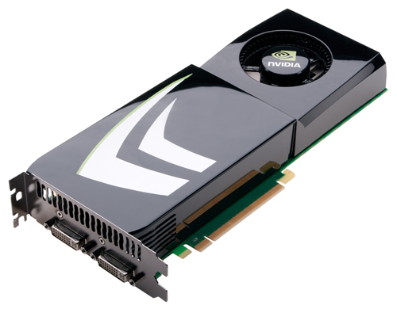
Neural Nets and GPU’s
Many operations in Neural Net training can happen in parallel
Reduces to matrix operations, many of which can be easily parallelized on a GPU.

Slide 19
A neural network
Layers and layers and layers of linear models and non-linear transformation
Around for about 50 years
Fell in “disfavor” in 90s
In last few years, big resurgence
Impressive accuracy on a several benchmark problems
Powered by huge datasets, GPUs, & modeling/learning algo. improvements
1
1
x₁
z₁
y
x₂
z₂

Slide 20
Convolutional Neural Nets
Hidden Layer
Input Layer

Slide 21
Convolutional Neural Nets
Strategic removal of edges
Hidden Layer
Input Layer

Slide 22
Convolutional Neural Nets
Strategic removal of edges
Hidden Layer
Input Layer

Slide 23
Convolutional Neural Nets
Strategic removal of edges
Hidden Layer
Input Layer

Slide 24
Convolutional Neural Nets
Strategic removal of edges
Hidden Layer
Input Layer

Slide 25
Convolutional Neural Nets
Strategic removal of edges
Hidden Layer
Input Layer

Slide 26

Convolutional Neural Nets
http://ufldl.stanford.edu/wiki/images/6/6c/Convolution_schematic.gif

Slide 27
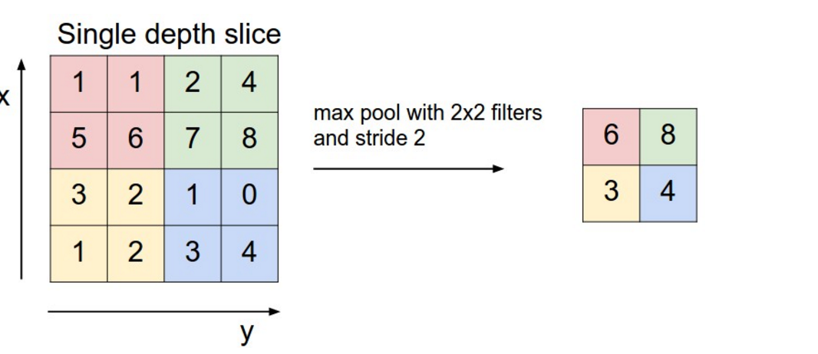
Pooling layer
http://cs231n.github.io/convolutional-networks/

Slide 28
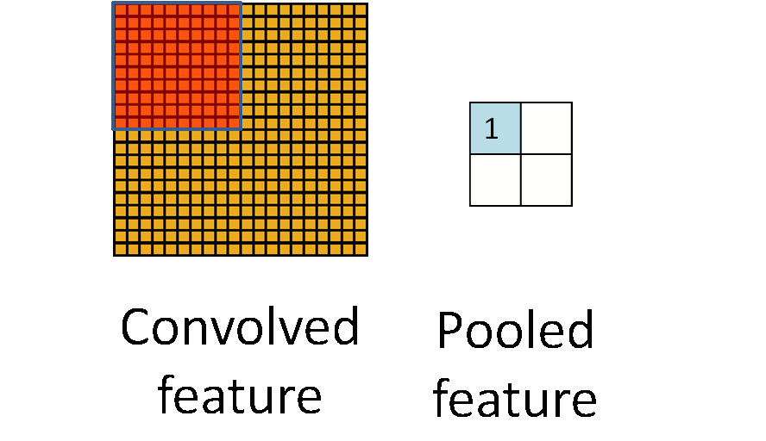
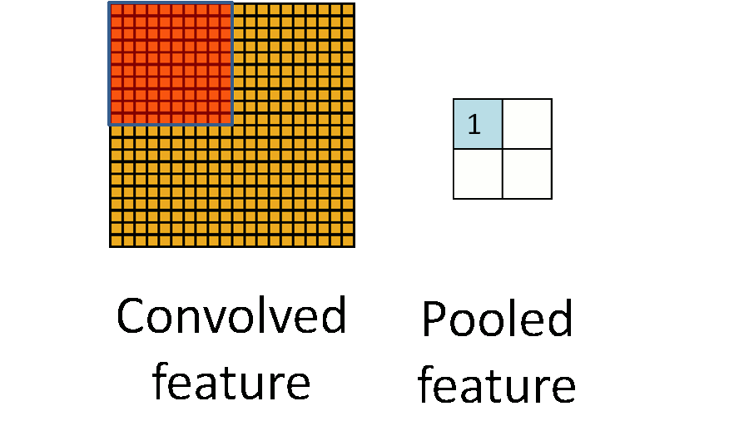
Pooling layer
http://ufldl.stanford.edu/wiki/images/6/6c/Pooling_schematic.gif

Slide 29
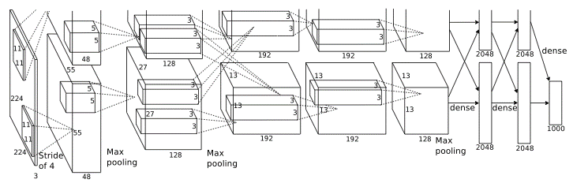
Final Network
Krizhevsky et al. ‘12

Slide 30
Applications to computer vision

Slide 31
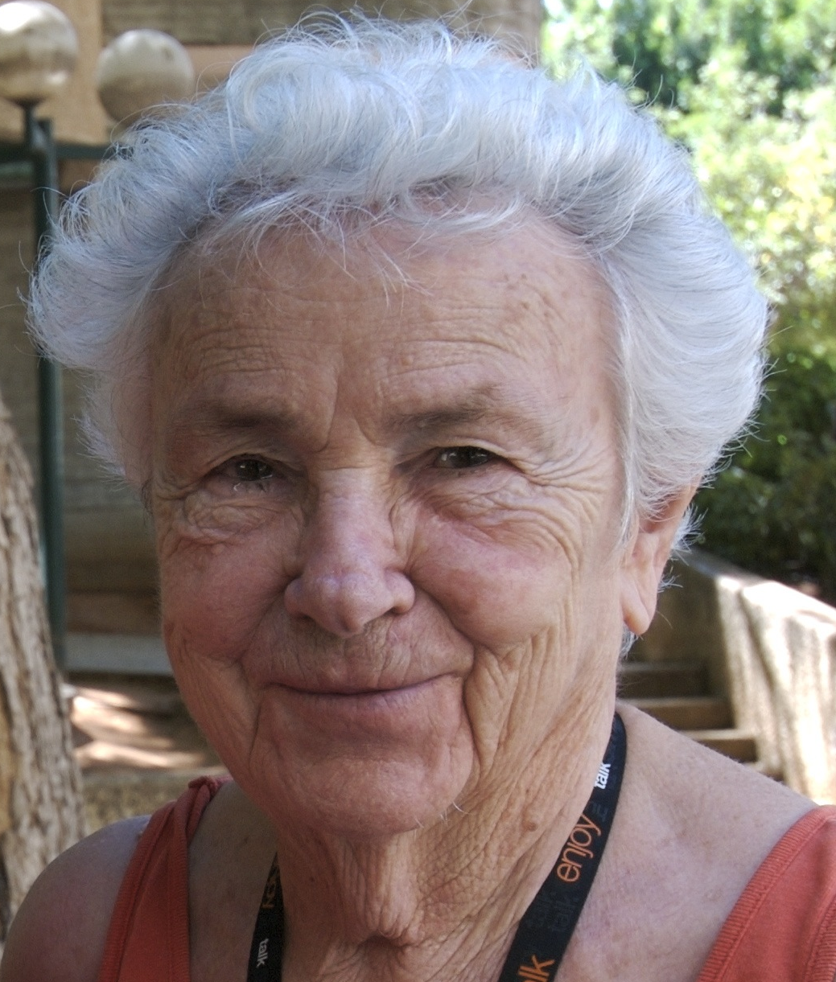
Image features
Features = local detectors
Combined to make prediction
(in reality, features are more low-level)
Nose
Eye
Face!
Eye
Mouth

Slide 32
Standard image classification approach
Use simple classifier
e.g., logistic regression, SVMs
Input
Extract features
Face

Slide 33
Many hand crafted features exist…
… but very painful to design

Slide 34
Change image classification approach?
Use simple classifier
e.g., logistic regression, SVMs
Input
Extract features
Can we learn features from data?
Face

Slide 35
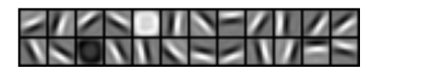
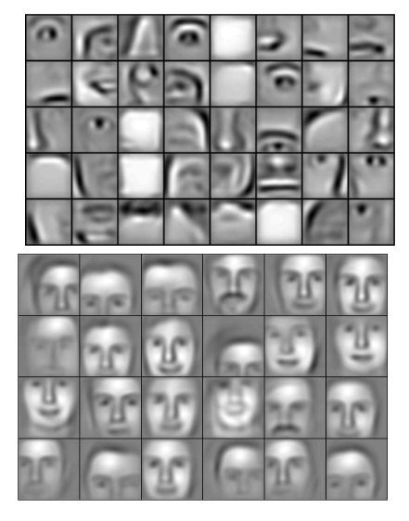
Use neural network to learn features
Input
Learned hierarchy
Output
Lee et al. ‘Convolutional Deep Belief Networks for Scalable Unsupervised Learning of Hierarchical Representations’ ICML 2009

Slide 36
Sample results
Traffic sign recognition (GTSRB)
99.2% accuracy
House number recognition (Google)
94.3% accuracy

Slide 37
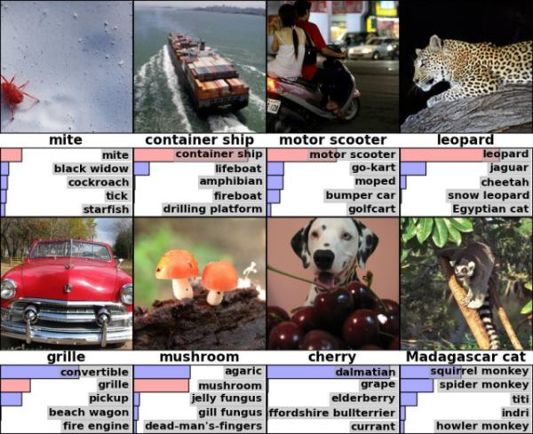
Krizhevsky et al. ’12: 60M parameters, won 2012 ImageNet competition

Slide 38
ImageNet 2012 competition: 1.2M images, 1000 categories

Slide 39
Application to scene parsing

Slide 40
Let’s build our own Image Classifier!

Slide 41
Challenges of deep learning

Slide 42
Deep learning score card
Pros
Cons
Enables learning of features rather than hand tuning
Impressive performance gains on
Computer vision
Speech recognition
Some text analysis
Potential for much more impact

Slide 43
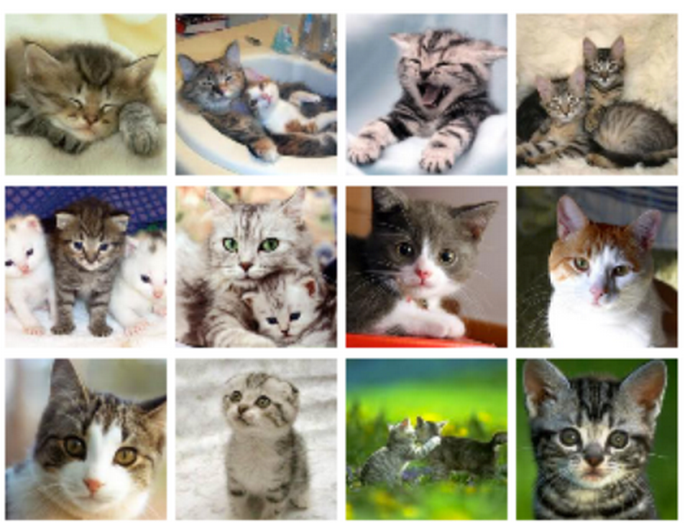
Deep learning workflow
Learn deep neural net model
Training set
Adjust hyper-parameters,
model architecture,…
80%
Lots of labeled data
Validate
20%
Validation set

Slide 44
Deep learning score card
Pros
Cons
Enables learning of features rather than hand tuning
Impressive performance gains on
Computer vision
Speech recognition
Some text analysis
Potential for much more impact
Computationally really expensive
Requires a lot of data for high accuracy
Extremely hard to tune
Choice of architecture
Parameter types
Hyperparameters
Learning algorithm
…
Computational + so many choices = incredibly hard to tune

Slide 45
Can we do better?
Input
Learned hierarchy
Output
Lee et al. ‘Convolutional Deep Belief Networks for Scalable Unsupervised Learning of Hierarchical Representations’ ICML 2009

Slide 46
Deep features: Deep learning + Transfer learning

Slide 47

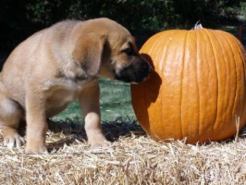
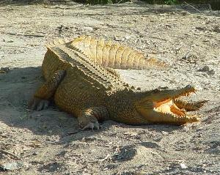
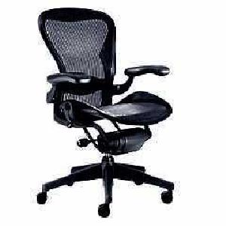
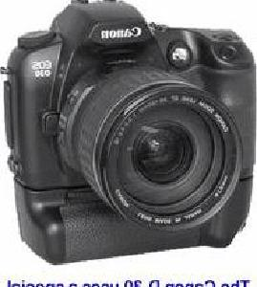
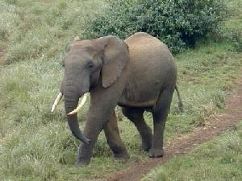
Transfer learning: Use data from one domain to help learn on another
Lots of data:
Learn neural net
Great accuracy
Old idea, explored for deep learning by Donahue et al. ’14
Some data:
Neural net as feature extractor
+
Simple classifier
Great accuracy on new problem

Slide 48
What’s learned in a neural net
Neural net trained for Task 1
vs.
More generic
Can be used as feature extractor
Very specific to Task 1

Slide 49
Transfer learning in more detail…
For Task 2, learn only end part
Use simple classifier
e.g., logistic regression, SVMs
Class?
Neural net trained for Task 1
More generic
Can be used as feature extractor
Keep weights fixed!
Very specific to Task 1

Slide 50
Using ImageNet-trained network as extractor for general features
Using classic AlexNet architechture pioneered by Alex Krizhevsky et. al in ImageNet Classification with Deep Convolutional Neural Networks
It turns out that a neural network trained on ~1 million images of about 1000 classes makes a surprisingly general feature extractor
First illustrated by Donahue et al in DeCAF: A Deep Convolutional Activation Feature for Generic Visual Recognition

Slide 51
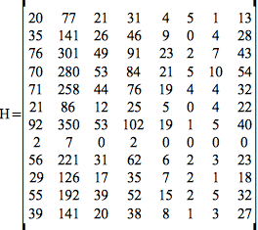
Transfer learning with deep features
Learn simple model
Training set
Extract features with neural net trained on different task
80%
Some labeled data
Validate
20%
Validation set
Deploy in production

Slide 52

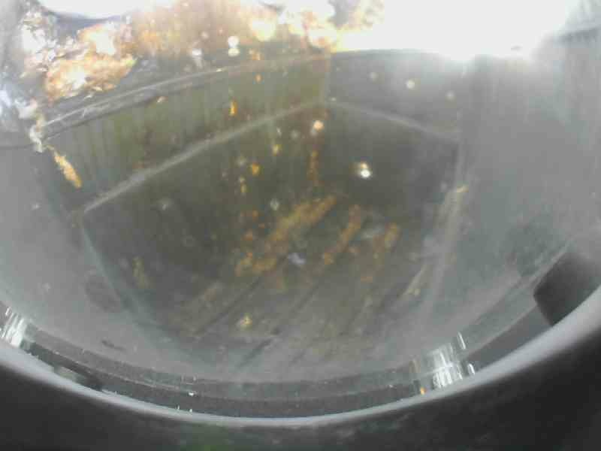
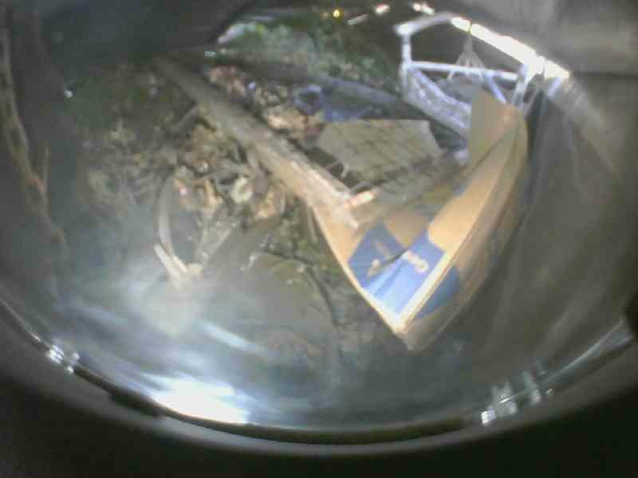
In real life

Slide 53
What else can we do with Deep Features?

Slide 54


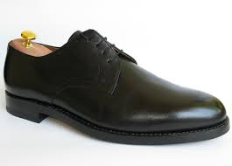

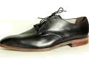
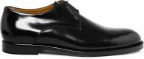
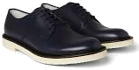

Finding similar images

Slide 55
Image Similarity
Vectorizing images entails embedding images as vectors
Vectors may encode raw pixels or more complex transformations of the pixels
Similarity is derived from a distance function, usually geometric distance
a₁
a₂
.
.
.
a_{k}
similarity(A,B)
raw images
vectorize
b₁
b₂
.
.
.
b_{k}

Slide 56
Finding similar images
B - A
A
B
A - C
B - C
C
A
B
C
Notes:
Distance – distance between the extracted features. Each set of extracted features for an image forms a vector.
Images whose deep visual features are similar have similar sets of extracted features.
We can measure quantitatively how similar two images are by measuring the Euclidean distance between these sets of features, represented as a vector.
Explain nearest neighbors.
- Each image has same # of deep features. - This creates a space, where each dress is a point. - More similar images are closer together, distance-wise, in that space.

Slide 57
Finding Similar Dresses!

Slide 58
Bonus: Applications to text data

Slide 59
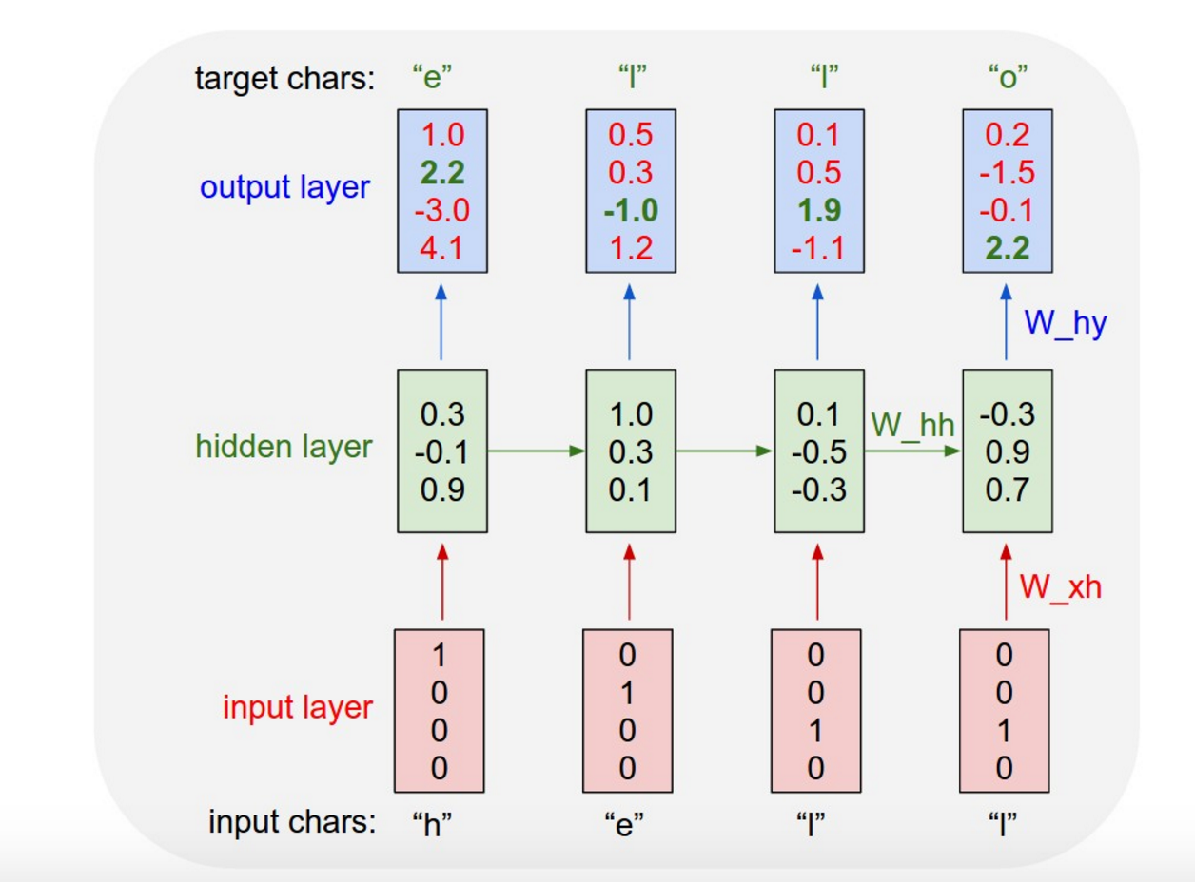
Recurrent Neural Networks
http://karpathy.github.io/2015/05/21/rnn-effectiveness/
Notes:
Distance – distance between the extracted features. Each set of extracted features for an image forms a vector.
Images whose deep visual features are similar have similar sets of extracted features.
We can measure quantitatively how similar two images are by measuring the Euclidean distance between these sets of features, represented as a vector.
Explain nearest neighbors.
- Each image has same # of deep features. - This creates a space, where each dress is a point. - More similar images are closer together, distance-wise, in that space.

Slide 60
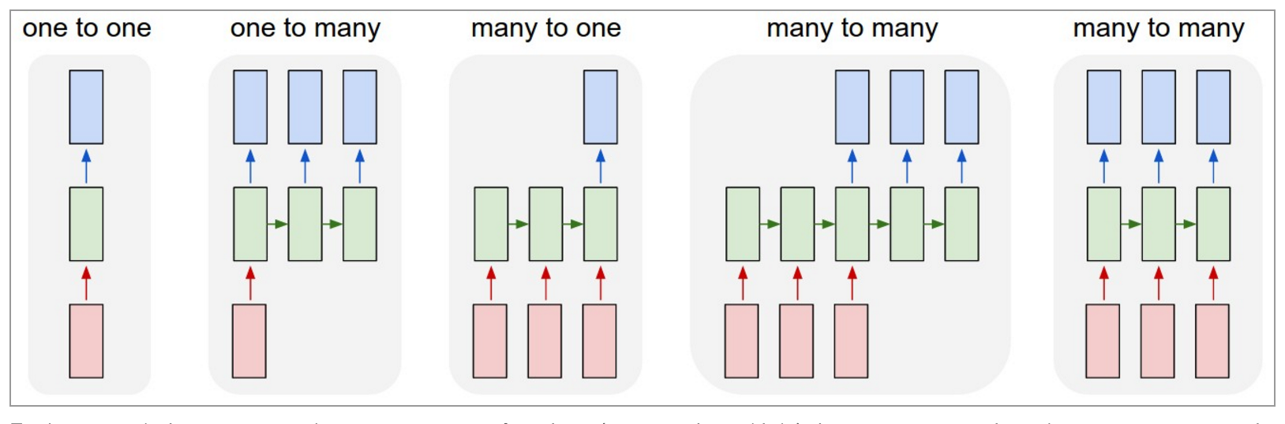
Recurrent Neural Networks
http://karpathy.github.io/2015/05/21/rnn-effectiveness/
Notes:
Distance – distance between the extracted features. Each set of extracted features for an image forms a vector.
Images whose deep visual features are similar have similar sets of extracted features.
We can measure quantitatively how similar two images are by measuring the Euclidean distance between these sets of features, represented as a vector.
Explain nearest neighbors.
- Each image has same # of deep features. - This creates a space, where each dress is a point. - More similar images are closer together, distance-wise, in that space.

Slide 61

Simple text classification with bag of words
aardvark 0
about 2
all 2
Africa 1
apple 0
anxious 0
...
gas 1
...
oil 1
…
Zaire 0
Use simple classifier
e.g., logistic regression, SVMs
Class?
One “feature” per word

Slide 62
Word2Vec: Neural network for finding word representation
Mikolov et al. ‘13
Skip-gram Model: From a word, predict nearby words in sentence
Viewed as deep features
dog
Neural net
A
went
for
a
walk

Slide 63
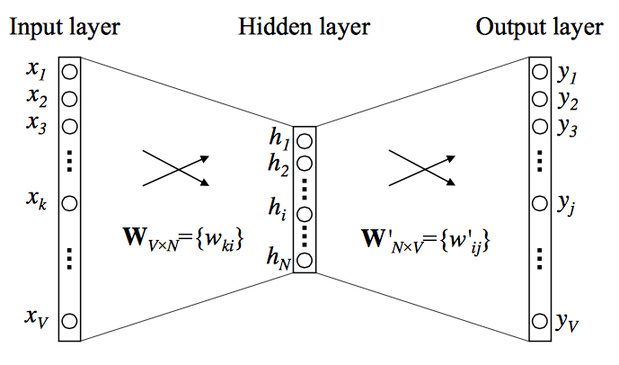
Word2Vec: Neural network for finding high dimensional representation per word
Mikolov et al. ‘13
http://www.folgertkarsdorp.nl/word2vec-an-introduction/

Slide 64
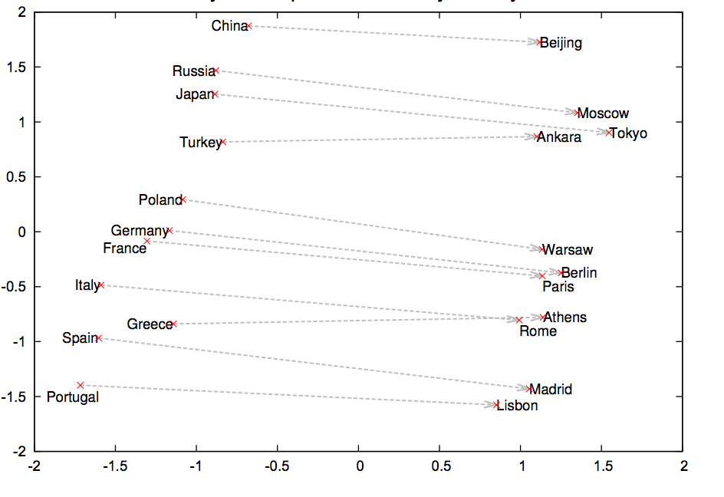
Related words placed nearby high dim space
Projecting 300 dim space into 2 dim with PCA (Mikolov et al. ’13)

Slide 65
Blog corpus
Haha
Yea
Hahaha
Hahah
Lisxc
Umm
Hehe laughingoutloud
Closest words in 300 dim
LOL
Predicts gender of author with 79% accuracy

Slide 66
Summary

Slide 67
Deep learning made easy with deep features
Deep learning: exciting ML development
Slow, lots of tuning, needs lots of data
Deep features: reuse deep models for new domains
Needs less data
Faster training times
Much simpler tuning
Can still achieve excellent performance

Slide 68
Thanks!
Download
pip install graphlab-create
Docs
https://dato.com/learn/
Source
https://github.com/dato-code/tutorials/tree/master/strata-sj-2016

Slide 69
Thank you!

